Slide 1

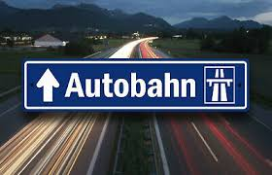

Traffic Sign Recognition
A Deep Learning Exercise to Classify Street Signs
by
Robert Harris

Slide 2
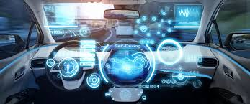
The Future Driving Experience
No Manual
No Automatic
NO HANDS!
Autonomous cars are the future.

Slide 3
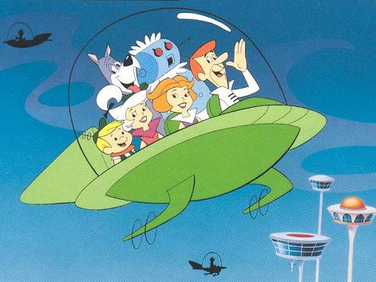
Fully Automated Cars by 2030:
Market volume grows to 13.7 billion USD.
27.5B USD investment in 2018 alone!
1 in 10 global cars self-driving.
Robo-taxis top applicant.
https://www.statista.com/press/p/autonomous_cars_2020/

Slide 4
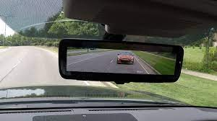
Caution - Merging Autonomous Cars:
It’s simply a matter of time.
Objects in rear view are closer than they appear.
Are we ready?

Slide 5
Possible Positives:
Lower accidents caused by human error.
Prevent drunk driving incidents.
Relieve traffic jam stress. Sit back & relax.
Similar to taking a limousine.

Slide 6
Possible Negatives:
Who is liable in an accident?
Costs involved with ownership?
Major shift in automotive labor force.
Safety issues?

Slide 7

#1 Concern - Safety:
CPU’s image recognition capabilities.
Goal: Create a machine learning program to accomplish classifying street signs at an acceptable rate of accuracy.

Slide 8
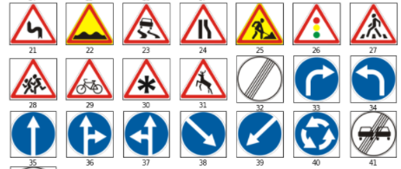
Task – Image Classification:

Slide 9
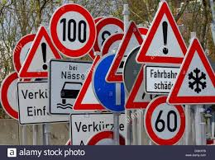
Dataset:
Kaggle - GTSRB
German Traffic Sign Recognition Benchmark
43 Signs - Labels
Over 50K images
Now what?

Slide 10

Convolutional Neural Network:
Deep learning algorithm
Assign weights and biases to inputs
Filter & activate inputs-> neurons-> outputs
Model learns and differentiates patterns
Repeated through multiple layers
Final output predicts an outcome.

Slide 11
Why CNNs:
Trained to interpret sophistication of images better than other deep learning methods.
Successfully captures the spatial and temporal dependencies in images through improved filtering.
Performs better fitting of images through reusability of weights and a reduction in parameters required.

Slide 12
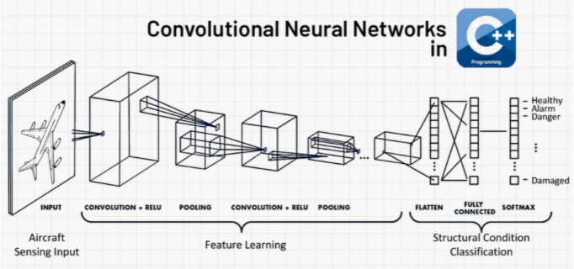

Slide 13

Pre-Process Dataset:
Data augmentation – reduce overfitting
Standardize – 3 channels (RGB)
Build & Train the Model :
Hidden layers
ReLU activation
Added dropout – combat overfit
Softmax as the output activation
Evaluate & Predict:
98.8 % Accuracy
Test on unseen data
Process:

Slide 14
Results – Training & Validation Data(40k):
Accuracy
98.8% - Good but good enough?
Probably increase with ideal conditions.
Probably decrease with:
Poorly lit signs
Obstructed images
Inclement weather

Slide 15
Results – Unseen Test Data(10k):
Predictions
93% weighted precision – poor
3 poorest predictors:
Label 27 correct 58% (n = 53)
Label 30 correct 62% (n = 121)
Label 29 correct 72% (n = 78)

Slide 16
Future Investigation:
Separate test images into categories based on quality.
Specifically investigate the highest percent of wrongly predicted labels.
Continue research and development with:
Vehicle speed
Time and distance considerations

Slide 17
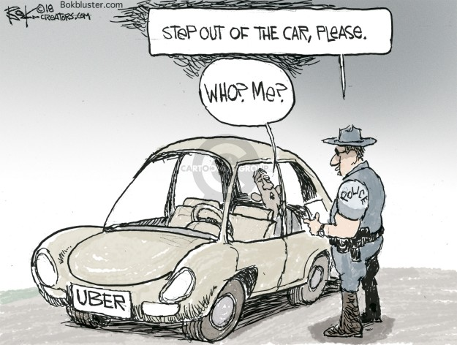
1 in 10 by 2030?

